Slide 1



executive agriculture analysis

Slide 2

Learning Objectives
- Understanding Data Sources in Agriculture
- Data Preparation and Transformation
- Data Modeling:
- Creating Interactive Dashboards and Visualizations:
GOAL
- Business Insights and Decision-Making
- Improving Decision-Making with KPIs:

Slide 3
Tools and Technology used
1. Power BI (Core Tool):
Power BI Desktop
Power BI Service
Power BI Mobile
Power BI Embedded
2. Data Sources & Integration Tools:
Excel
SQL Databases
APIs & Web Services
SharePoint/OneDrive
3. Data Transformation Tools:
Power Query Editor
DAX (Data Analysis Expressions)

Slide 4
Methodology
Set goals (e.g., crop yield predictions, resource optimization).
Identify required data (e.g., weather, market prices, crop data).
Data Collection & Integration
Gather data from sources (IoT sensors, APIs, farm systems).
Integrate data into Power BI (Excel, SQL, SharePoint).
Data Cleaning & Transformation
Clean and normalize data using Power Query.
Transform raw data into usable formats.
Data Modeling
Build relationships between datasets.
Use DAX for calculated measures (e.g., yield, profitability).
Analysis & Visualization
Perform trend and predictive analysis.
Design interactive dashboards using Power BI visuals (maps, KPIs).

Slide 5
Problem Statement:
The agricultural industry faces challenges in optimizing crop yields, managing resources efficiently, and responding to dynamic market conditions. Decision-makers struggle with a lack of real-time, integrated data to guide strategic planning. There is a need for an advanced analytical solution that consolidates diverse data sources (e.g., weather, soil health, market prices) and provides actionable insights for improving productivity, reducing costs, and increasing profitability. The goal is to leverage Power BI to create an interactive, data-driven platform that enables executives to make informed decisions based on predictive analytics and real-time information.

Slide 6
Solution:
To address the challenges faced by agricultural decision-makers, we propose developing a comprehensive Power BI dashboard that integrates multiple data sources, including weather patterns, crop yields, soil health, and market prices. This solution will:
Centralize Data: Integrate real-time and historical data from various sources (IoT sensors, weather APIs, farm management systems, etc.) into Power BI.
Advanced Analytics: Apply predictive analytics and forecasting models to predict crop yields, market trends, and resource requirements, helping executives anticipate challenges and opportunities.
Interactive Dashboards: Create user-friendly, interactive dashboards with visualizations such as maps, trend charts, and KPIs that allow executives to explore data in-depth and make informed decisions.
Automation & Alerts: Set up automated alerts for critical events like weather changes, price fluctuations, or low crop yields, ensuring timely action.
Data-Driven Decision Making: Provide actionable insights and recommendations for optimizing farming practices, improving resource allocation, and enhancing profitability.

Slide 7
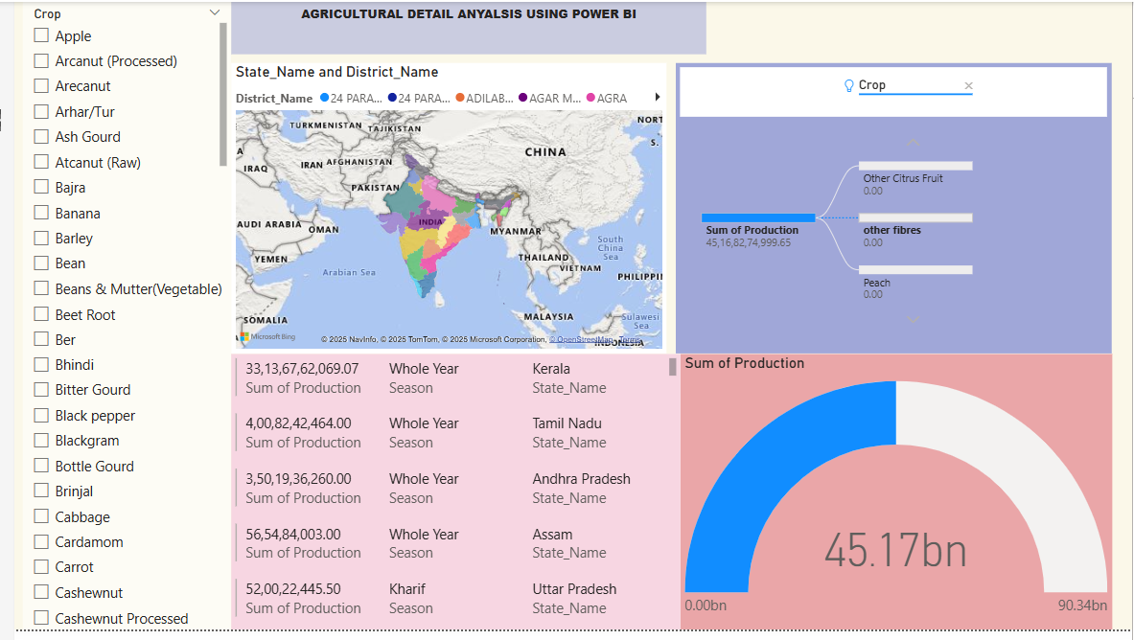
Screenshot of Output:

Slide 8
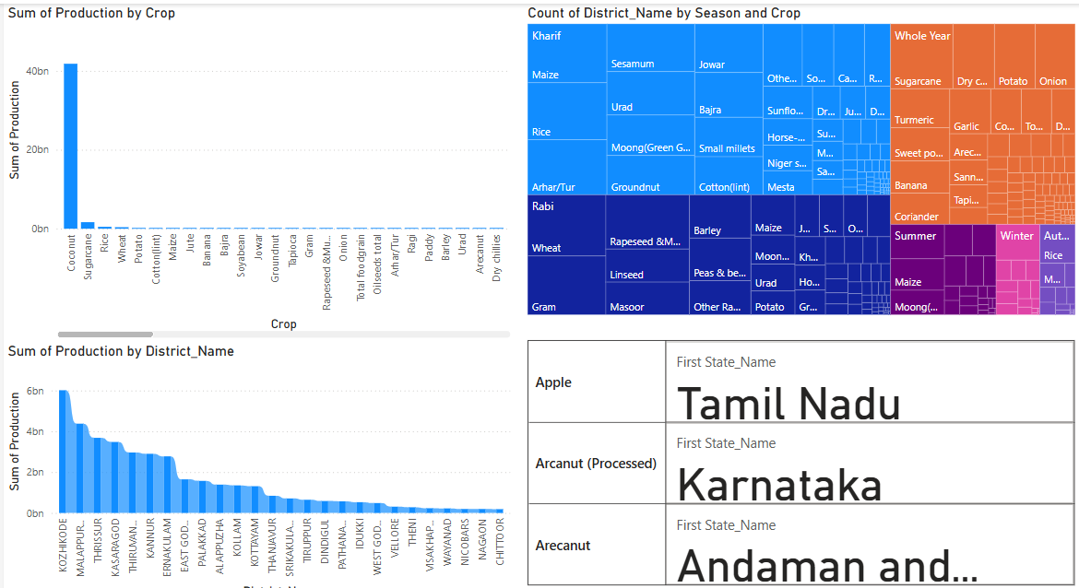
Screenshot of Output:

Slide 9
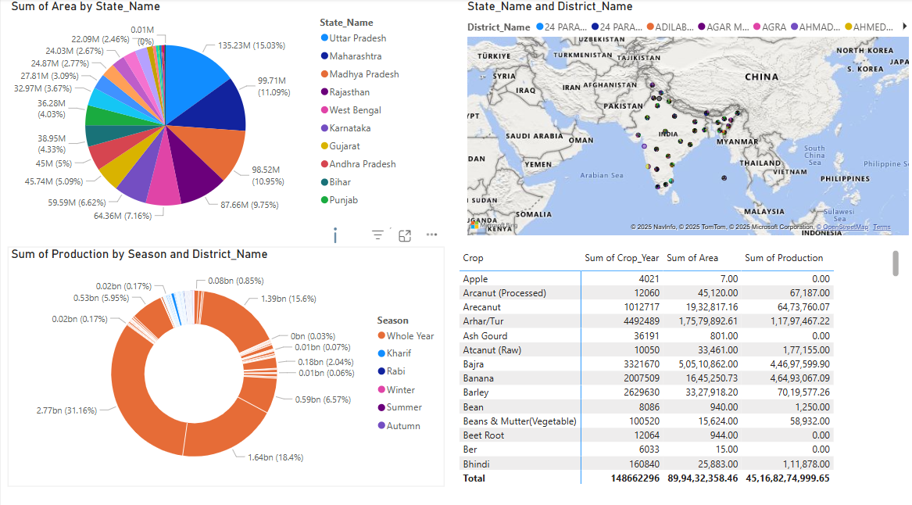
Screenshot of Output:

Slide 10
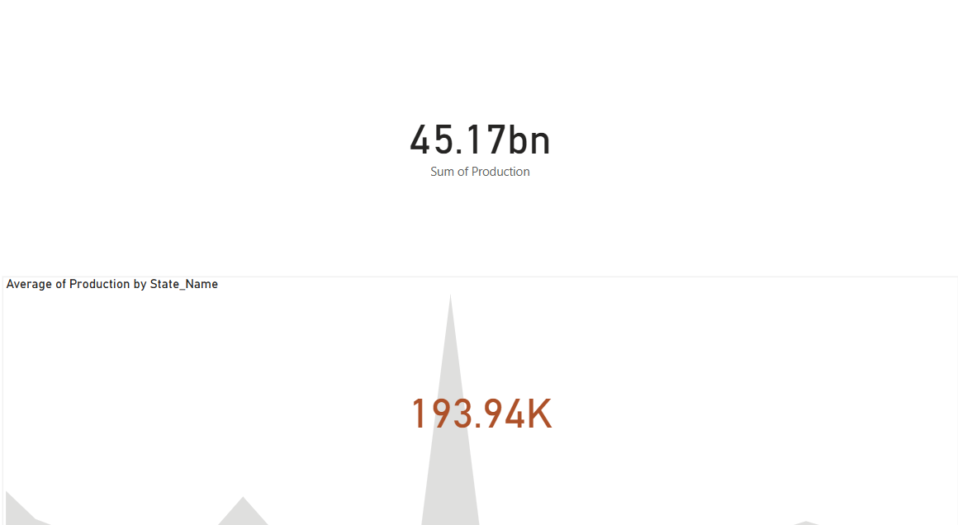
Screenshot of Output:

Slide 11
Conclusion:
By leveraging Power BI for agricultural data analysis, we can transform raw, fragmented data into valuable insights that drive smarter decision-making. The integration of multiple data sources, combined with advanced analytics and real-time reporting, enables executives to proactively address challenges, optimize resource use, and increase profitability. This solution empowers stakeholders to make data-driven decisions that improve crop yield predictions, manage risks, and respond to market dynamics more effectively. Ultimately, this project provides a scalable, sustainable framework for enhancing agricultural productivity and ensuring long-term success in a competitive industry.

